Slide 1
Wastewater Hydraulics
Kay Curtin

Slide 2
Weight and Volume
1 cubic foot of water weighs 62.4 pounds
1 cubic foot contains 7.48 gallons of water
For liquids, specific gravity is used to convert to actual pounds of a liquid
Formula is sp.gr. = weight of liquid divided by weight of water
The specific gravity of water is 1.0
Anything higher will float
Anything lower will sink

Slide 3
Force and Pressure
Force
Pressure
Force: the push or pull influence that causes motion
Force = weight
Example: 1 cu.ft. of water = 62.4 pounds of force
Pressure = Force/Area
Ex.: pounds/sq.in. (psi)
Feet of head is related to pressure
1 psi = 2.31 ft. of head
1 foot of head = 0.433 psi

Slide 4
Head
STATIC HEAD: Discharge elevation – supply elevation
FRICTION HEAD: Energy losses due to friction (also referred to as HEAD LOSS)
VELOCITY HEAD: Energy losses to maintain velocity
TOTAL DYNAMIC HEAD: Static head + friction head + velocity head

Slide 5
Flow and discharge rate
Flow Equation
Changes in Velocity
Q = V x A
Q = Flow in cu.ft./sec.
V = Velocity in ft./sec.
A = Area in sq. ft.
Decrease in Area = Increase in Velocity
Increase in velocity = Decrease in Pressure

Slide 6
Piezometric Surface
Energy cannot be created or destroyed
In a closed system, the total energy is constant
ENERGY HEAD:
Energy units = foot-pounds
Head units = feet
PIEZOMETERIC SURFACE :
Pressure surface of water in a system
GROUNDWATER MONITORING:
Piezometers

Slide 7
Hydraulic machines (pumps)
STATIC = stopped or standing
Static head is the elevation of water in feet
DYNAMIC = flowing
Headloss = loss of pressure due to friction, which dissipates as heat, caused by:
pipe roughness,
pipe length
pipe diameter
velocity of the water

Slide 8
PUMPING HYDRAULICS
Static Head: distance in feet between the suction and discharge water level
Suction Lift: when the eye of the impeller is ABOVE the water level that you are pumping
Suction Head: when the eye of the impeller is BELOW the water level being pumped
Total Dynamic Head: the sum of static head, headloss, and velocity head

Slide 9
WHY DO WE MEASURE FLOW?
Required in discharge permit
Determining hydraulic loading to WWTP
Determining organic loading to WWTP
Monitoring internal process flows (sludge return or wasting rates)
Controlling and verifying chemical dosage rates
Monitoring I & I rates

Slide 10
TYPES OF FLOW MEASUREMENT
Differential Pressure
Magnetic
Venturi
Restricts flow and measures the drop in pressure
Orifice
Nozzle
Static tube
Measure the induced voltage caused by the flow of a conductive fluid between two electrodes, which translates to velocity

Slide 11
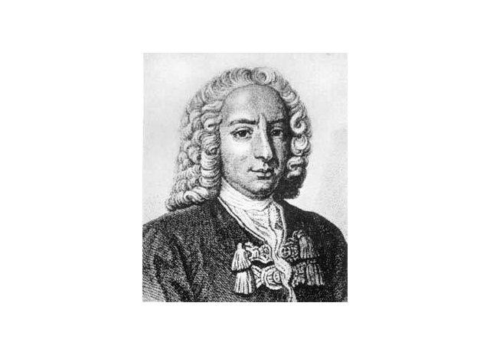
BERNOULLI’S PRINCIPLE
Bernoulli's principle states that an increase in the speed of a fluid occurs simultaneously with a decrease in pressure or a decrease in the fluid's potential energy. The principle is named after Daniel Bernoulli who published it in his book Hydrodynamica in 1738.

Slide 12
OTHER TYPES OF FLOW METERS
Ultrasonic (doppler)
Velocity (propellor or turbine)
Positive-displacement (piston, rotating disc)

Slide 13
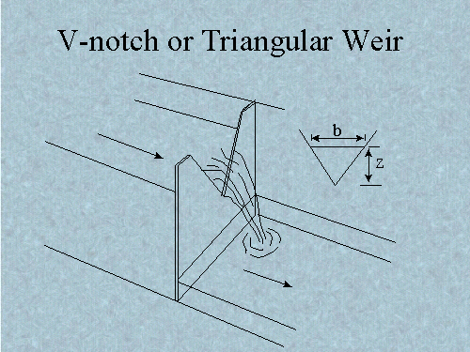
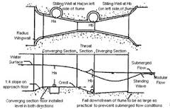
OPEN CHANNEL FLOW METERS
Weires
Flumes
V notch
Parchall Flume
Parshall

